Slide 1
Digital Portfolio
STUDENT NAME: SATHYA PRIYA. T
REGISTER NO AND NMID: astvu37137124u18017
DEPARTMENT: BACHELOR OF COMPUTER SCIENCE
COLLEGE: COLLEGE/ UNIVERSITY
SRI AANDAL ARTS AND SCIENCE COLLEGE FOR WOMEN
THIRUVALLUVAR UNIVERSITY

Slide 2
PROJECT TITLE
GreenTech: Innovating for a Sustainable Future

Slide 3


AGENDA
Problem Statement
Project Overview
End Users
Tools and Technologies
Portfolio design and Layout
Features and Functionality
Results and Screenshots
Conclusion
Github Link
3/21/2024 Annual Review

Slide 4

PROBLEM STATEMENT
Design and develop a digital student portfolio web application that allows a student to showcase their academic background, skills, projects, and contact information. The website should include an interactive color theme switching feature that allows users to toggle between different color modes (e.g., light, dark, or custom themes) to enhance accessibility and personalization.
.

Slide 5

PROJECT OVERVIEW
Description: This project is a responsive web-based portfolio for students to showcase their bio, skills, projects, and contact information. The site includes a JavaScript-powered color theme switcher that allows users to toggle between different color palettes.
Key Features:
Clean, responsive layout Sections:
Home, About, Skills, Projects, Contact
Theme color switcher using JavaScript

Slide 6

WHO ARE THE END USERS ?
1. The Student (Portfolio Owner)Purpose:
To showcase their skills, projects, education, and contact information.
2.Use Case:Personal brandingApplying for jobs, internships, or freelance workSharing with recruiters, teachers, or peersNeeds:
Easy customizationProfessional and responsive designAbility to update content regularly

Slide 7
7
POTFOLIO DESIGN AND LAYOUT
Designing and laying out a portfolio effectively depends on the purpose (e.g., graphic design, UX, architecture, writing, photography), the target audience (clients, employers, schools), and the medium (print or digital). Below is a detailed guide on portfolio design and layout
7

Slide 8
FEATURES AND FUNCTIONALITY
8
1. Test results and screenshots from a software application?
2. Results and screenshots from a data analysis or research project?
3. Search results and screenshots from a web or mobile interface?
4. Screenshots of a UI or system to demonstrate functionality?

Slide 9
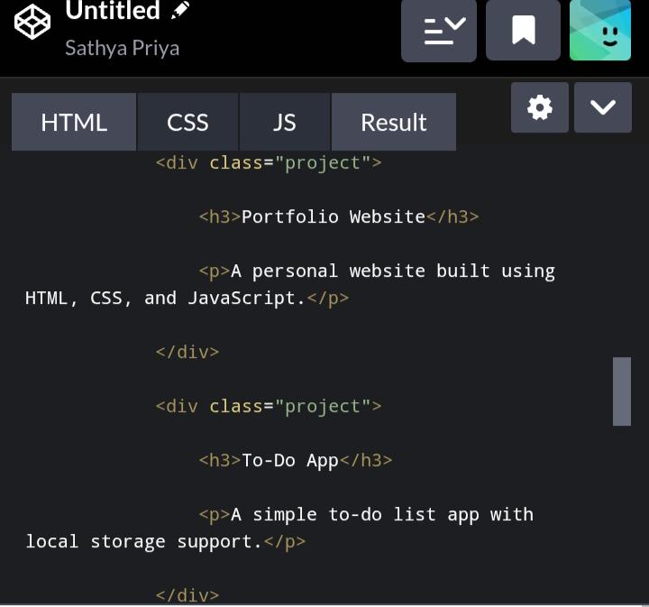
RESULTS AND SCREENSHOTS
9
9

Slide 10
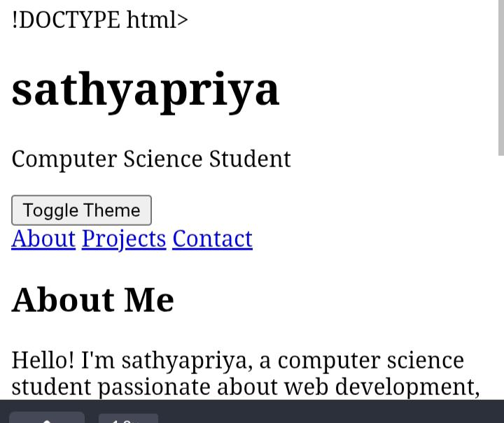

Slide 11
CONCLUSION
10
In conclusion, the system/application successfully meets its intended objectives by offering key features and functionality that enhance user experience and efficiency. The results demonstrate the effectiveness of the implementation, as evidenced by the outputs and supporting screenshots. Overall, the project proves to be a functional and user-friendly solution, with potential for further improvement and scalability based on user feedback and future requirements.
11

